Slide 1

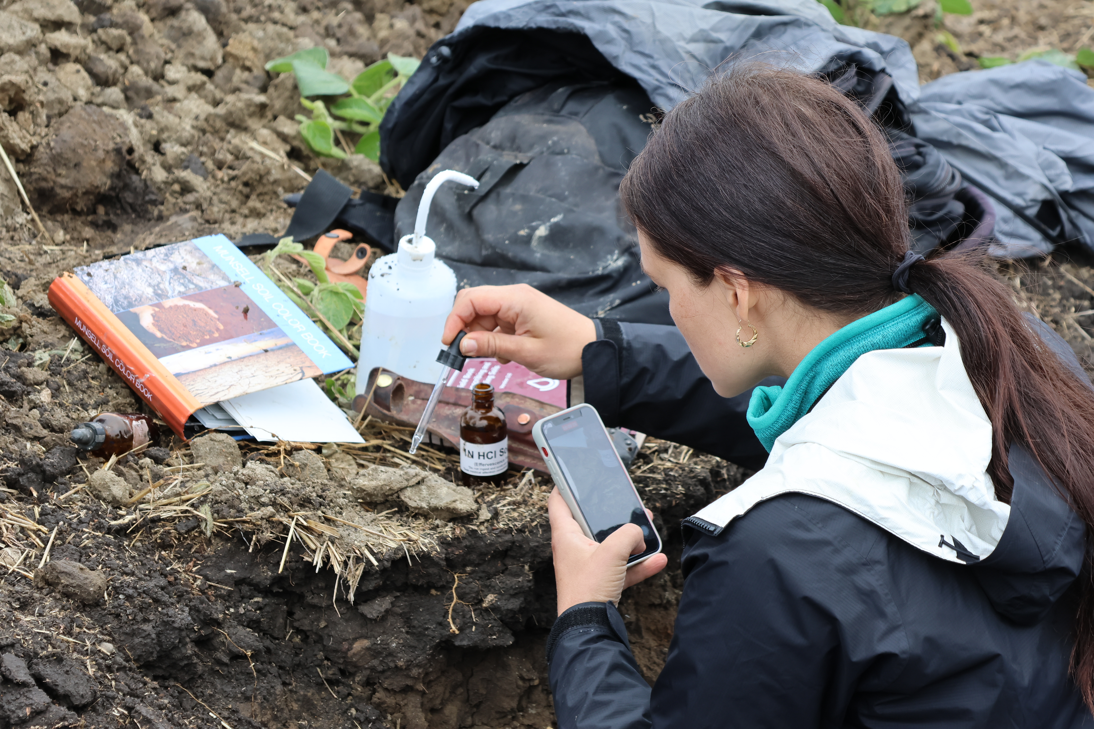
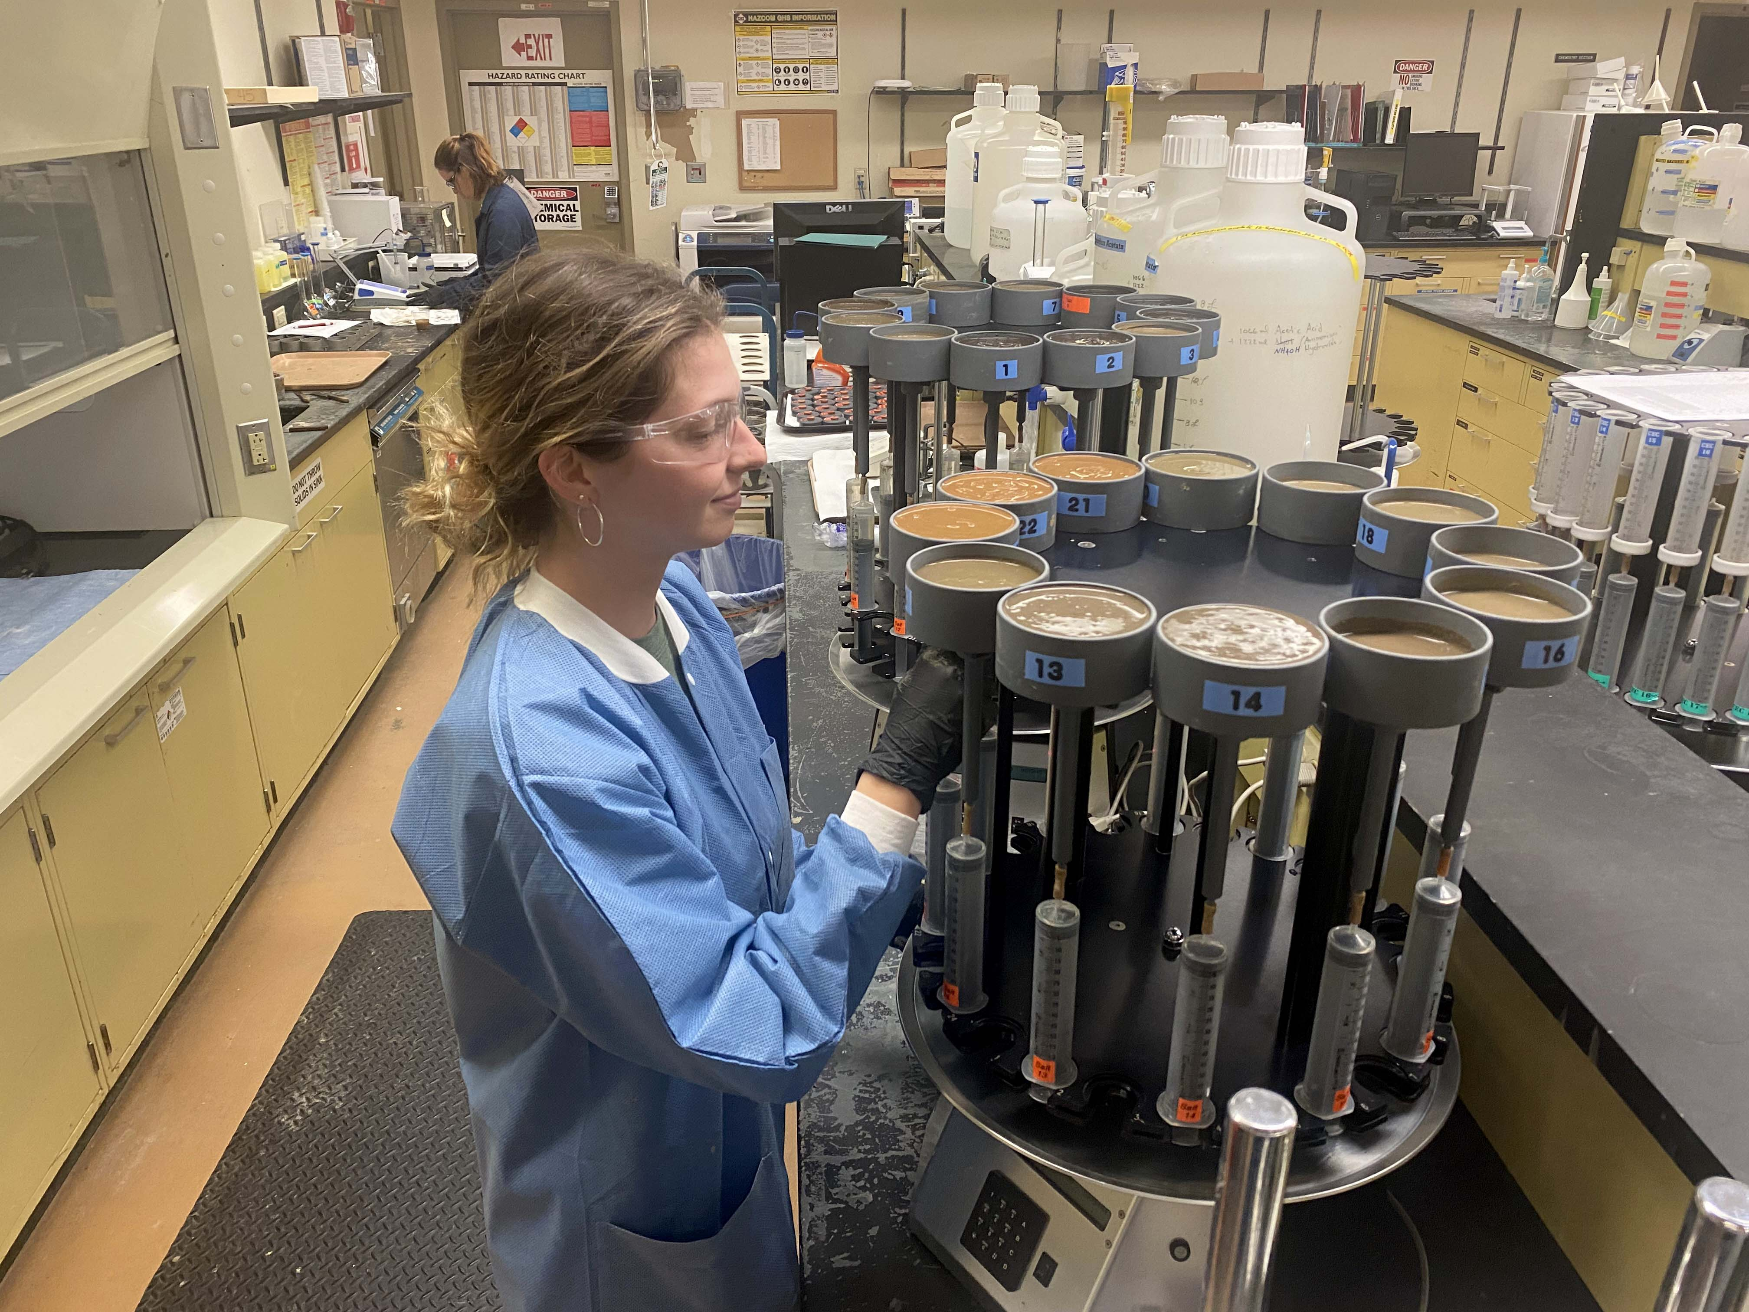

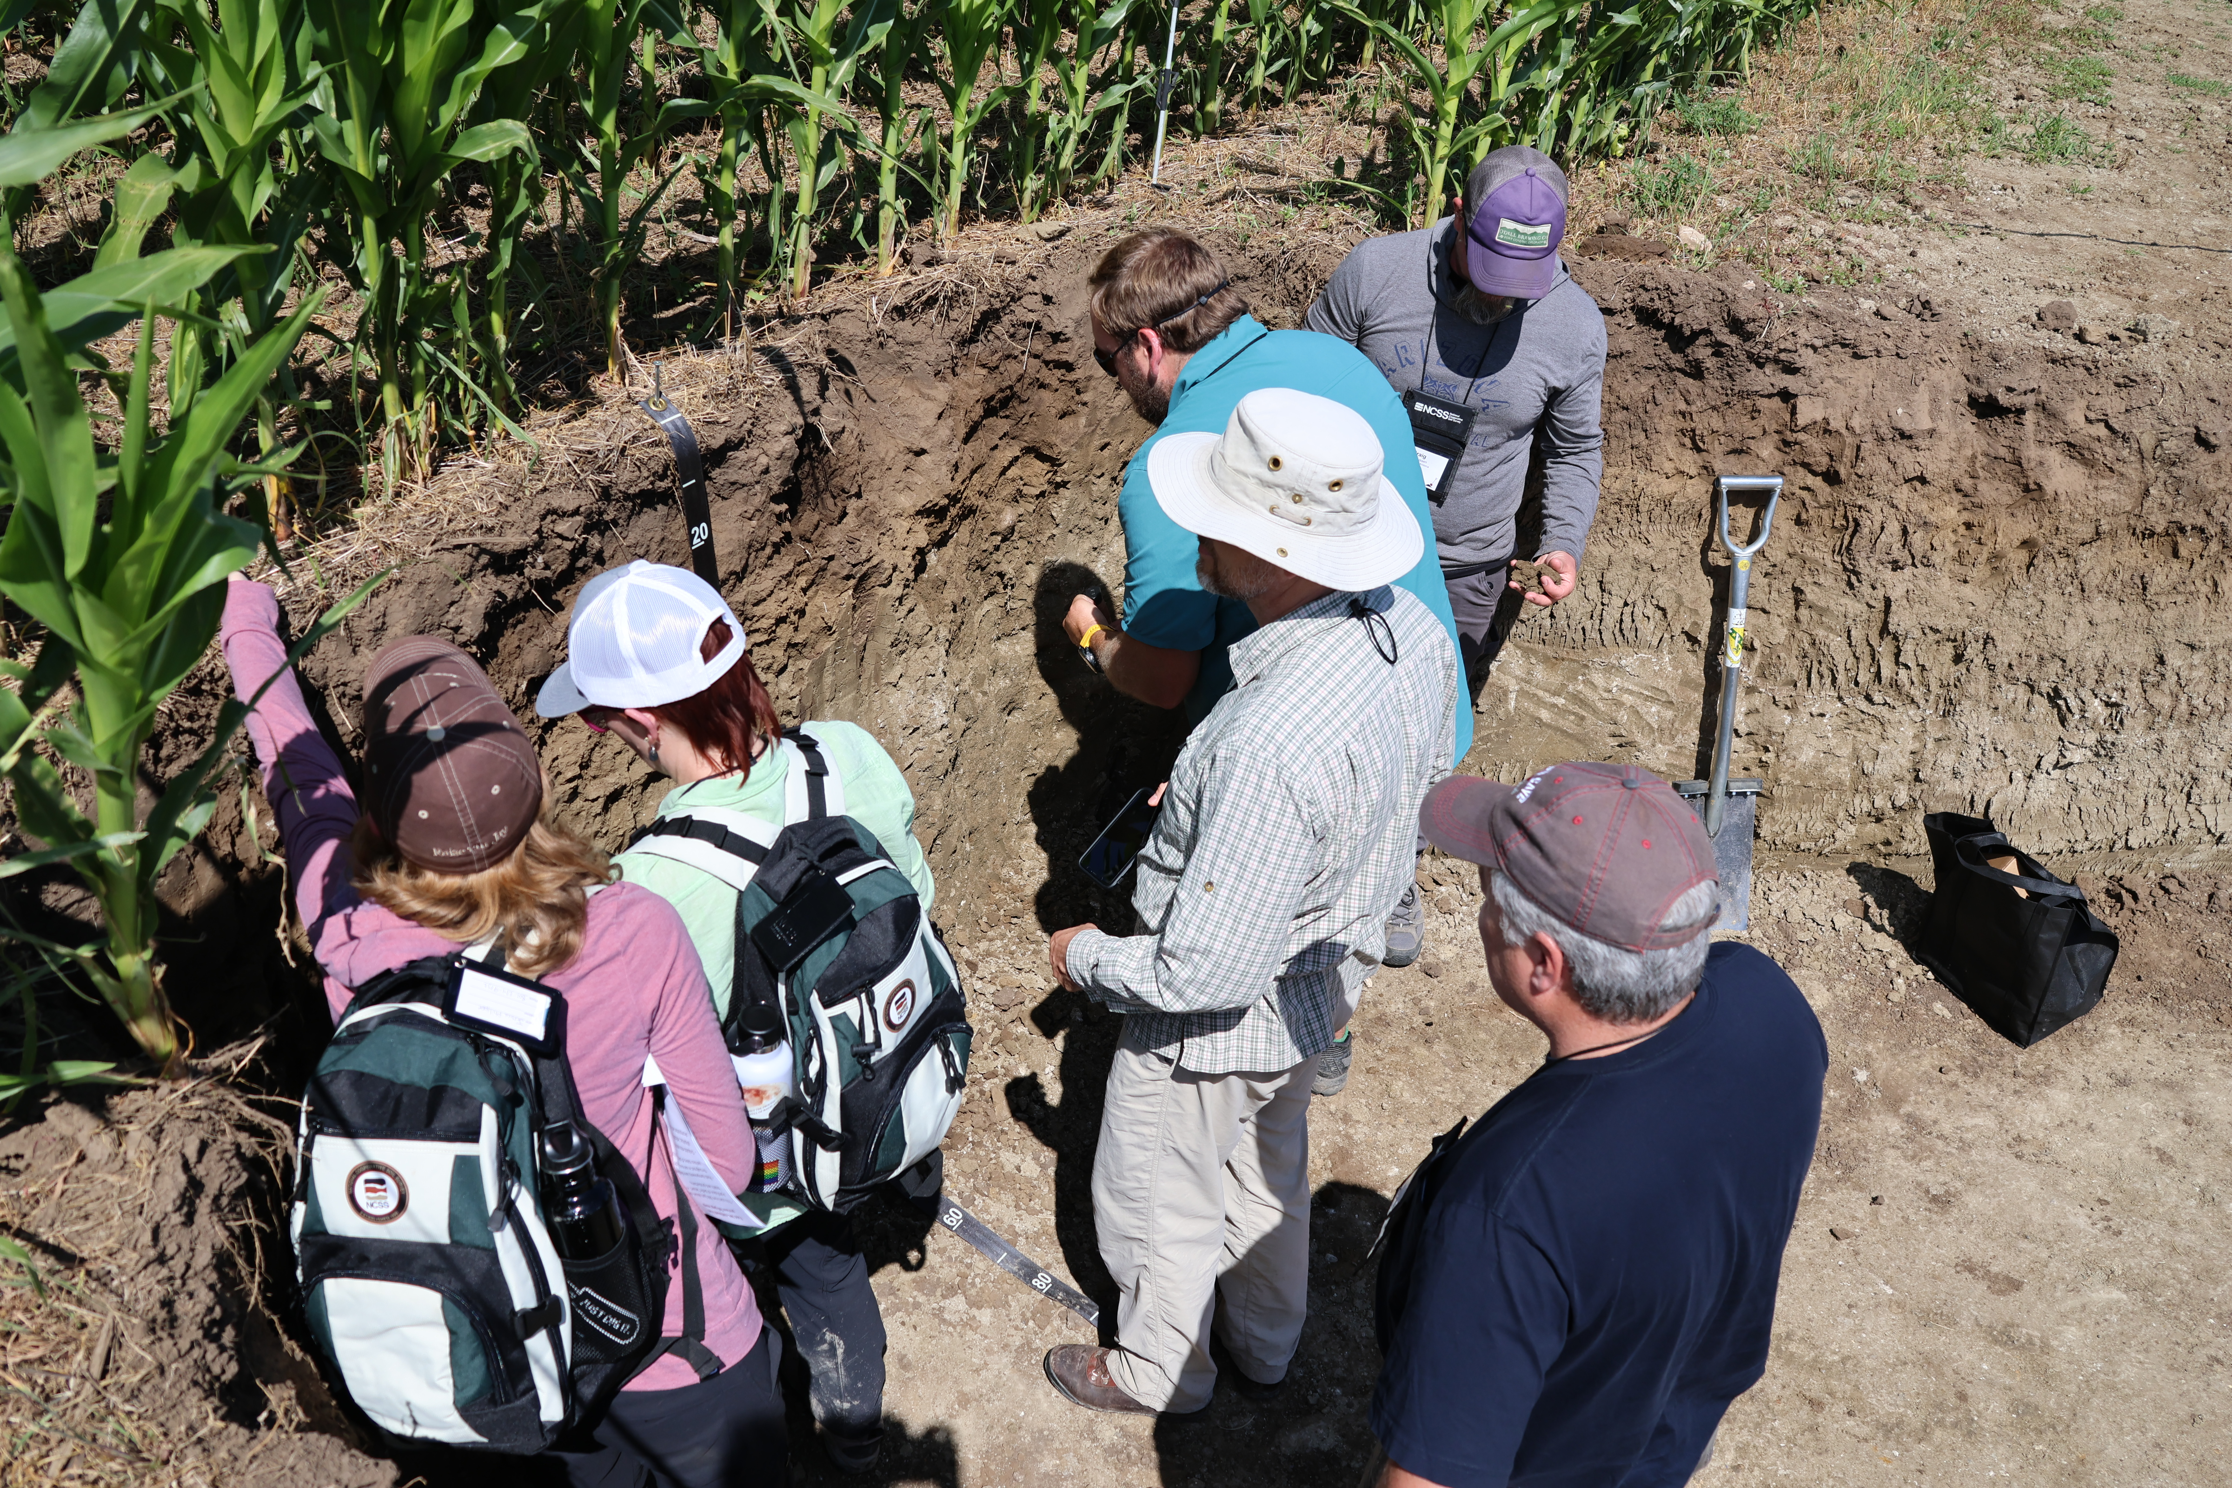
Sampling

Slide 2
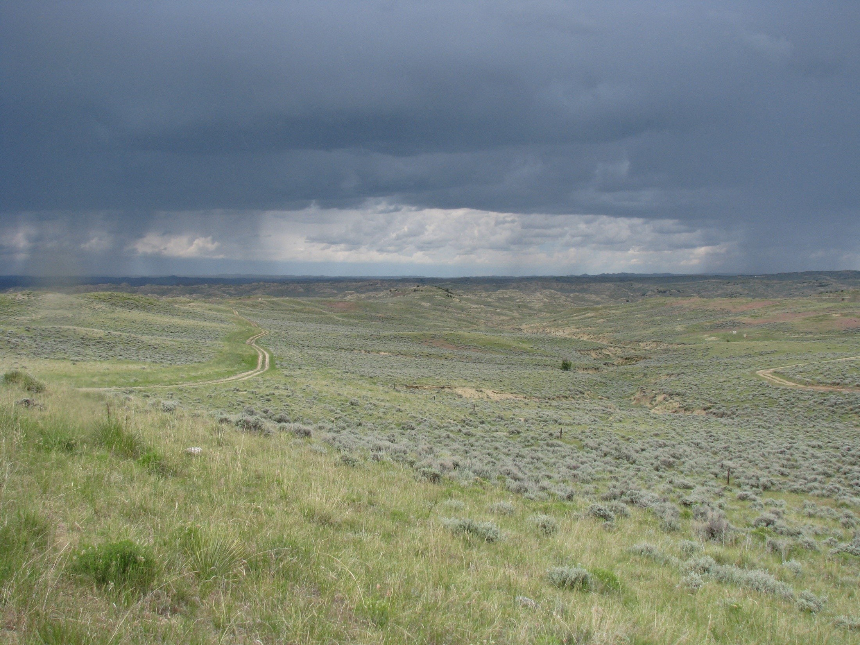
The Problem

Slide 3
Outline
Introduction
Terms
Considerations
Sampling Designs
Purposive
Probability
Weighting
Geometric
Sample size
Standard error
Confidence interval
Power Analysis
Prediction Error
Distance/area/time
Rules of Thumb
NSSH 627.8
Notes:
Why is this important? What comes first the chicken or the egg. Sampling determines what can and can’t be said about the data that you collect. If the data that is collected is not representative, no amount of statistical magic can produce meaningful results. Historically it has been said that “statistics and soils don’t work”. This statement should has said “statistical analysis of soils data is not practical”. Considering the capabilities modern computers, and the wealth of environmental covariates available, this is rarely still the case. McKenzie and Gallant (2007) favor statistical sampling strategies were sampling densities are 1 site per 250 ha (617 acres).

Slide 4
Terms
Population = the thing we’re interested in
Sample = the thing we observe
Inclusion probability = chance of inclusion in sample
Support = area/volume/thickness observed
Geo-reference = where we observe
Bulking = mixing multiple samples over a given area (e.g. horizons, satellite pedons)
Blocking = averaging multiple samples over a given area (e.g. plots, transects, clusters)
Strata = subsets/groups within the population
Inference space = what we predict
Bias = systematic error/difference from the population
Variance = random error
Feature space = multidimensional space formed by the combination of variables (e.g. clorpt/scorpan )

Slide 5
Considerations
Time/money
What to sample
When to sample
Where to sample
How to sample
Access
Strata weights (proportional vs variance)
Full description
Lab characterization
Field note
Biological soil properties
Temperature, moisture, …

Slide 6
Sample Size
Standard error
Confidence interval (type I error)
Power (type II error)
Distance/time
NSSH 627.8
Prediction error
Rules of thumb

Slide 7
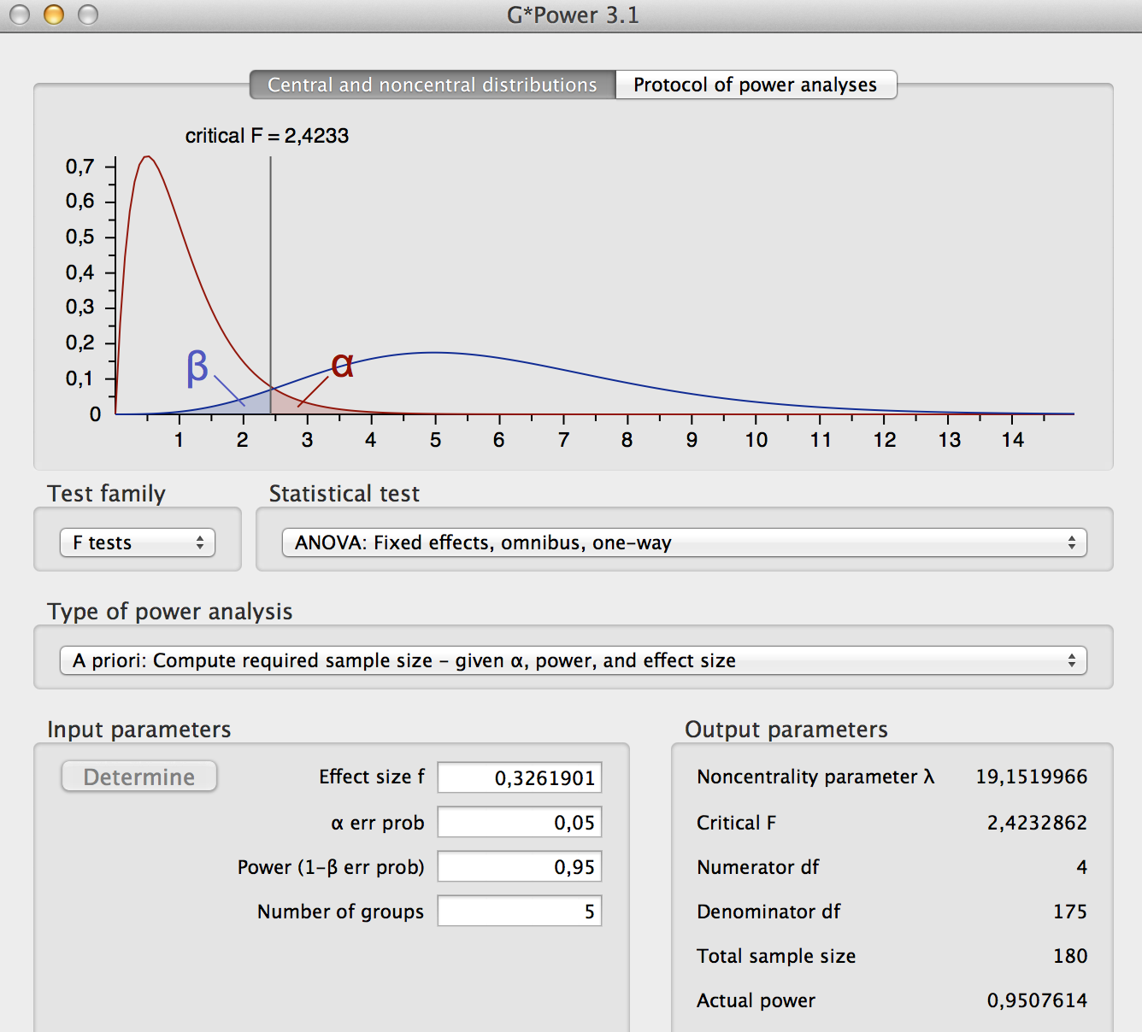
Sample Size
Standard Error approach tests whether our error is less than a threshold
Confidence Interval approach tests whether our data falls into 1 group
Power Analysis approach tests whether 2 groups overlap

Slide 8
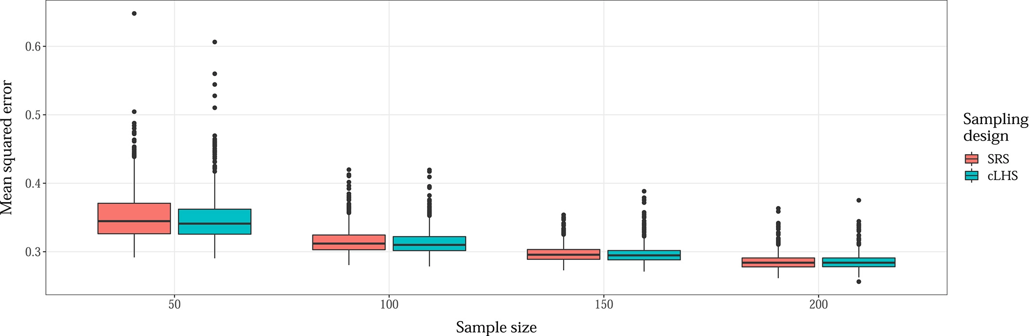
Sample Size vs Model Accuracy
From Wadoux and Brus, 2020

Slide 9
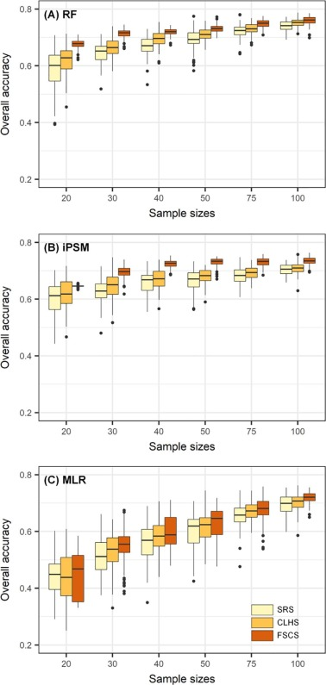
Sample Size vs Model Accuracy
From Ma et al., 2020

Slide 10
Sample Size – NSSH 627.8

Slide 11
Sampling Designs
Simple random
Stratified random
Multistage
Non-probability
Purposive (e.g. roadcuts)
Geometric (model based)
K-means (spatial coverage)
Experimental design
…
Clustered
Systematic (e.g. transect)
K-means (feature space)
Geostatistical
Balanced (e.g. Generalized Random Tessellation Stratified Sampling)
Conditioned Latin-hypercube (cLHS)
Probability (designed based)

Slide 12
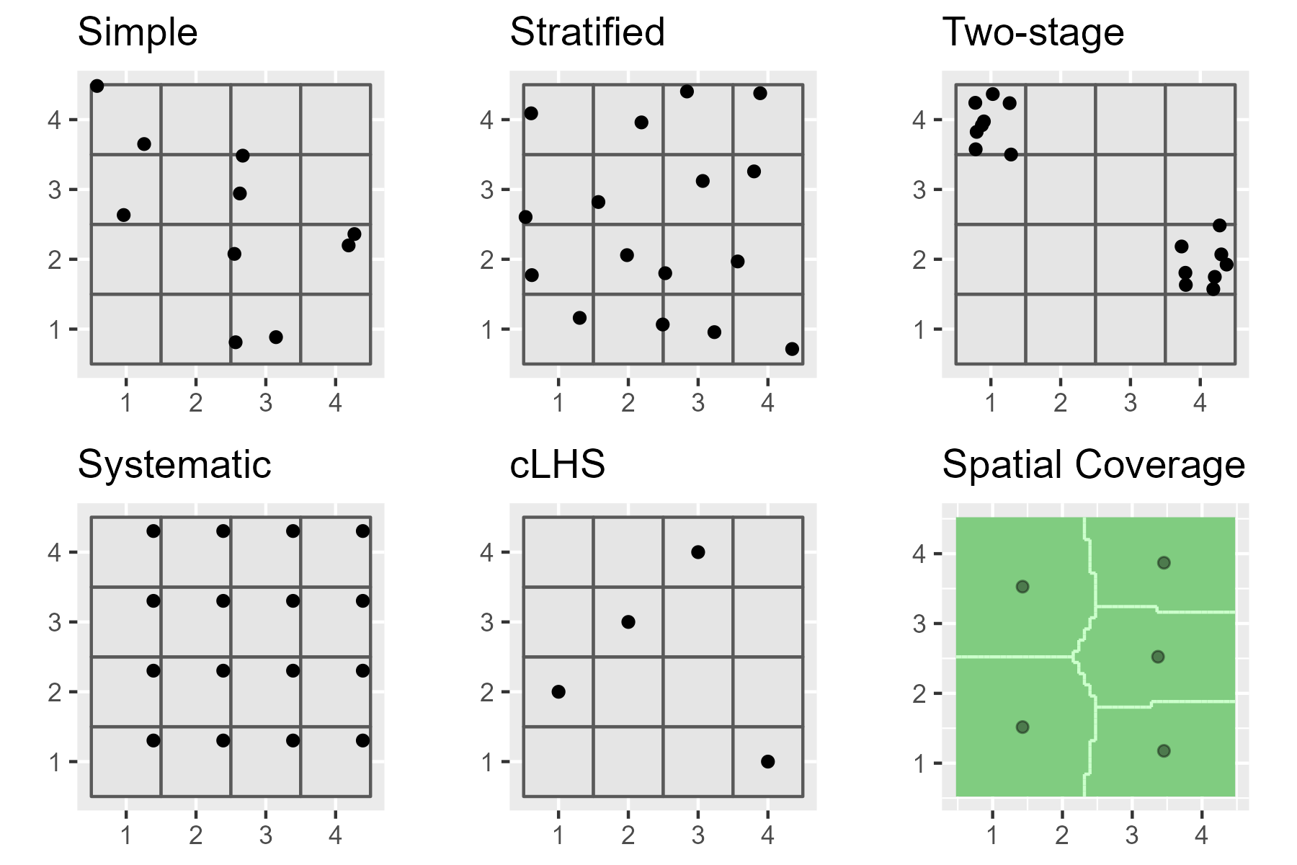
Sampling Designs

Slide 13
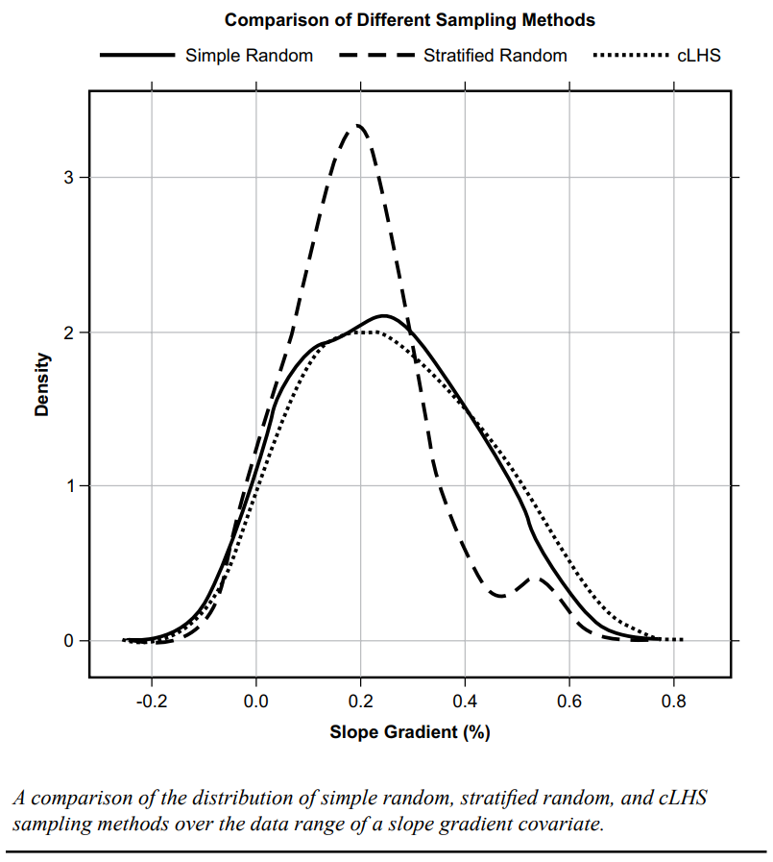
Sampling Designs

Slide 14
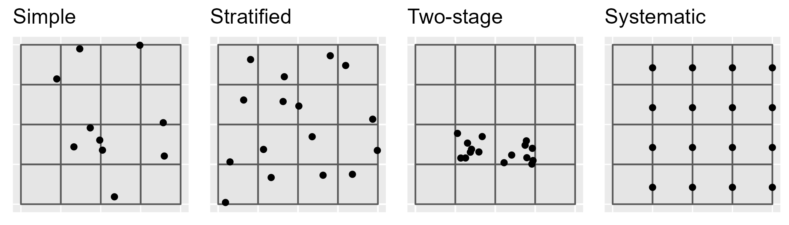
Simple Random Sampling (SRS)
Advantages
Disadvantages
Use cases
Simple
Unbiased (equal probability of inclusion)
Requires little prior knowledge of the population
Howell et al. (2004) - produced a “much more sensitive, more accurate, and greater range of estimated values” than the models from the subjective samples
Inefficient (requires large numbers)
Lower accuracy
Higher cost
Samples may not be representative of the feature attribute(s)
Uneven spatial distribution (e.g. clustered)
When you don’t know anything about the underlying population
When you can afford too (e.g. GIS simulations)

Slide 15
Systematic Sampling (SS)
Advantages
Disadvantages
Use cases
Simple
Precise estimates
Even spatial coverage
Greater efficiency
Biased estimates (particularly sampling variance)
May miss individuals that don’t coincide with the sampling interval
If so, the density needs to be increased
Limited utility for areas larger than a single field
Grid may not optimally fit irregular shapes
When you want to interpolate between observations (e.g. kriging)
When you want to detect/quantify spatial trends
When you can afford too (e.g. GIS simulations)
Individual fields
Flat landscapes

Slide 16
Stratified & Two-stage Random Sampling
Advantages
Disadvantages
Use cases
More efficient than simple-random
Higher accuracy
Lower cost
Sampling can be sized relative to proportion or variance
Require pre-existing knowledge of the population (which may be flawed)
If sampling is uneven, weights need to be known
May need to contrust the strata manually
When you have GIS layers that can be used as predictors (e.g. DSM)

Slide 17

Conditioned Latin Hypercube Sampling (cLHS)
Advantages
Disadvantages
Use cases
Maximumly stratifies the predictors
Automated sample selection
Incorporates cost constraints
Can incorporate legacy points
Easily scales to multiple GIS layers
Not ideal for map validation (non – probability sample)
Not ideal for developing map unit concepts (puts points in weird landscape positions)
Difficult to find alternatives for non-accessible points
Inefficient with large GIS layers
When you have GIS layers that can be used as predictors (e.g. DSM)

Slide 18
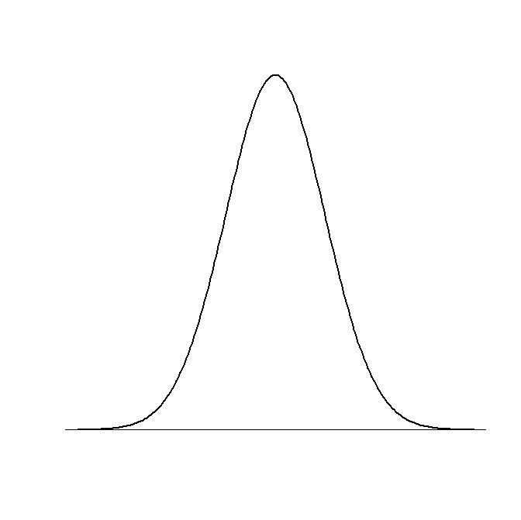
Conditioned Latin Hypercube Sampling (cLHS)
Equally probable intervals
Divides probability distribution of all variables
Equally probable intervals
Randomly samples inside intervals
Combines samples
Samples form a Latin Hypercube
But....
Sample combination may not
actually occur in data
Variable 1
Variable 2

Slide 19
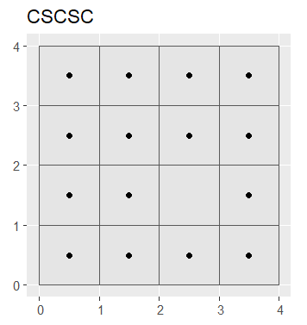
Covariate Space Coverage Sampling (i.e. k-means clustering)
Advantages
Disadvantages
Use cases
Maximumly stratifies the predictors
Automated sample selection
Can incorporates cost constraints
Can incorporate legacy points
Easily scales to multiple GIS layers
Not ideal for map validation (non – probability sample)
Ideal for developing map unit concepts (puts points in weird landscape positions)
Inefficient with large GIS layers
When you have GIS layers that can be used as predictors (e.g. DSM)

Slide 20
Kmeans vs cLHS
Kmeans sampling
Conditioned Latin Hypercube Sampling (cLHS)
Not a probability sample
Samples clusters
More ideal for developing map unit concepts
Easier to find alternatives for non-accessible points
Not a probability sample
Samples distributions
Not ideal for developing map unit concepts (puts points in weird landscape positions)
Difficult to find alternatives for non-accessible points

Slide 21
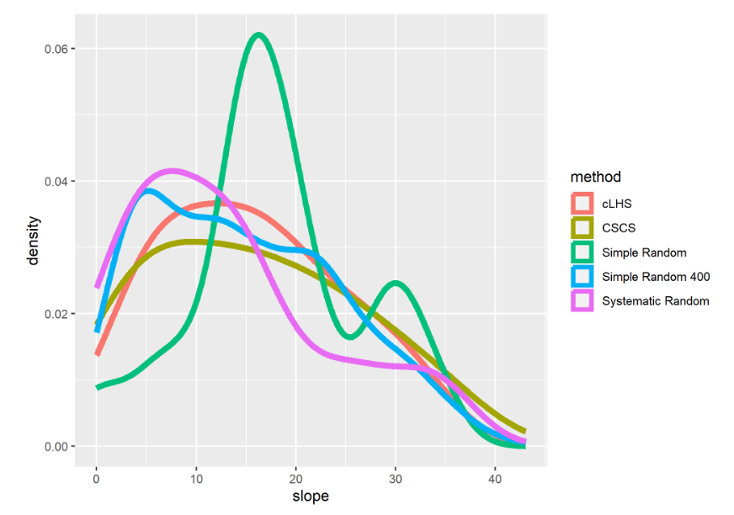
Density Comparison of 20 samples

Slide 22
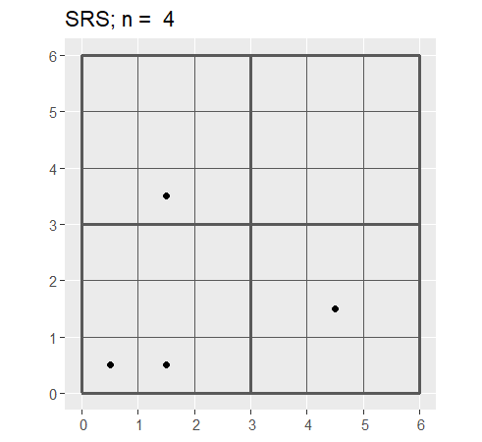
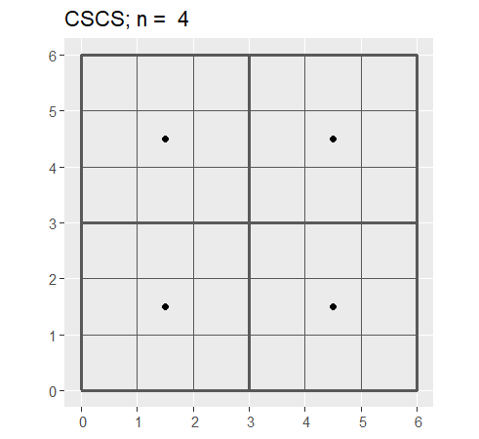
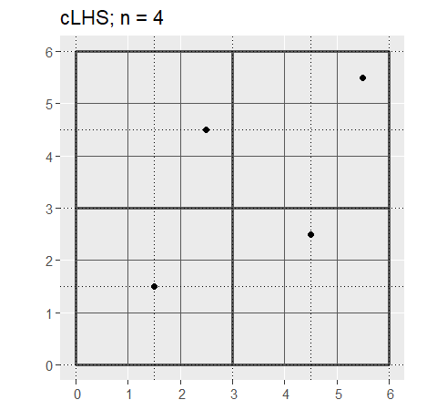
Comparison with 4 samples

Slide 23
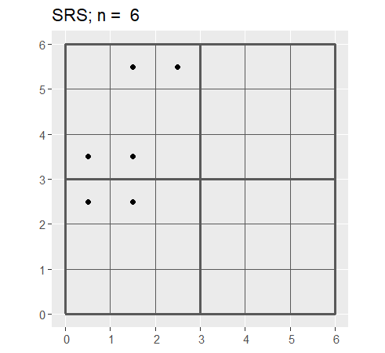
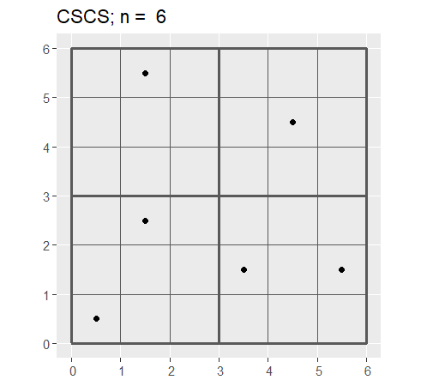
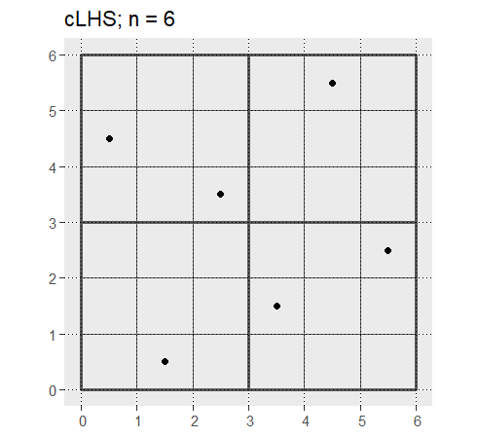
Comparison with 6 samples

Slide 24
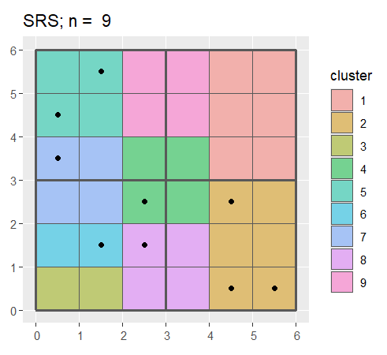
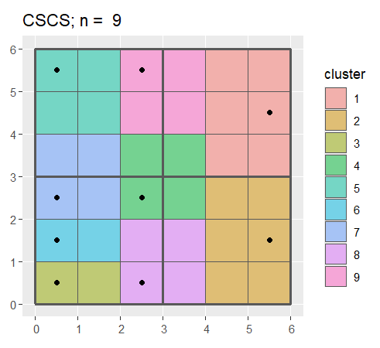
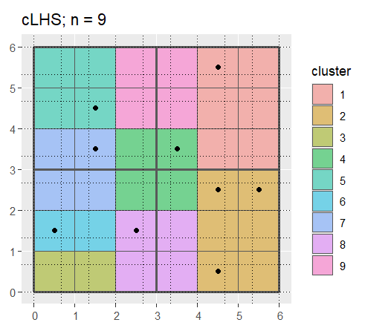
Comparison of clusters with 9 samples

Slide 25
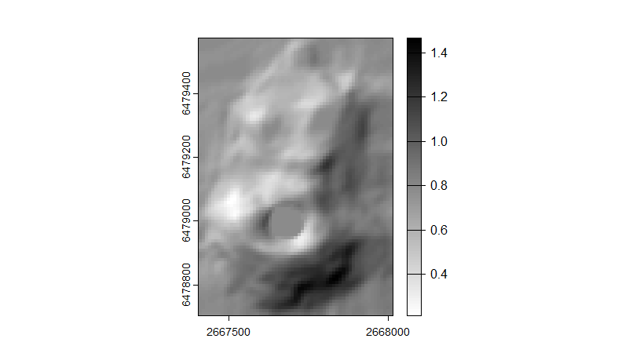
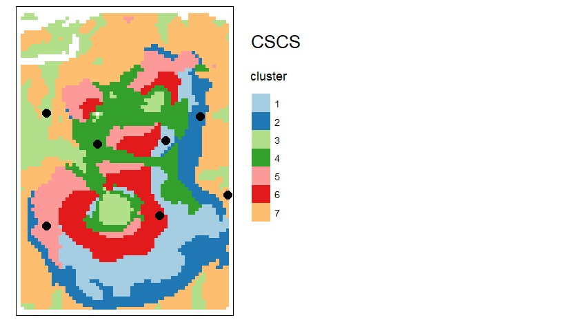
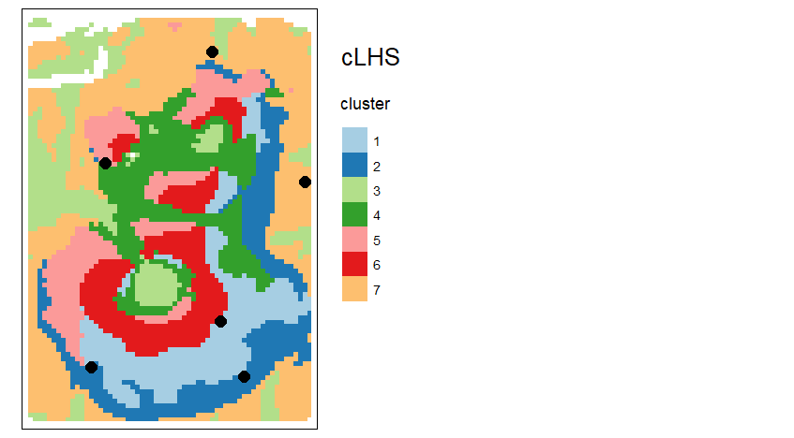
Example from the Volcano dataset

Slide 26
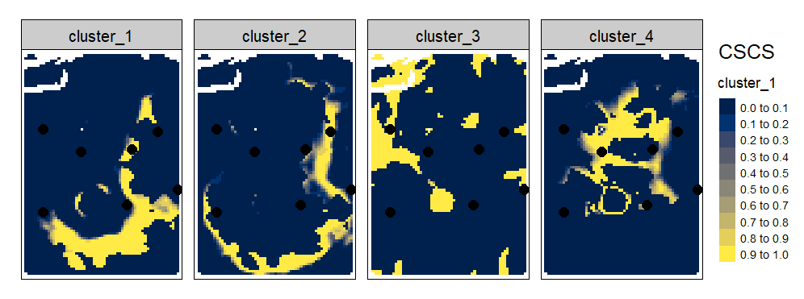
Examination the cluster probabilities

Slide 27
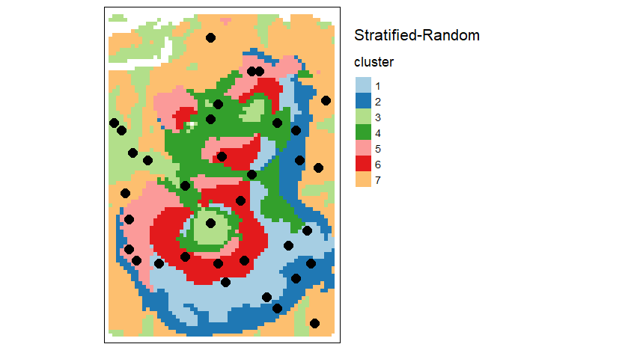
Adaptation to Stratified-Random Sampling

Slide 28
Overall Accuracy
From Ma et al., 2020

Slide 29
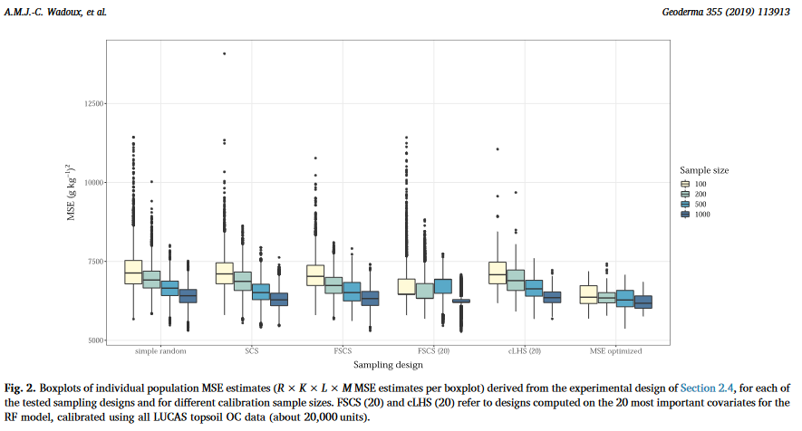
Mean Square Error (Regression)

Slide 30
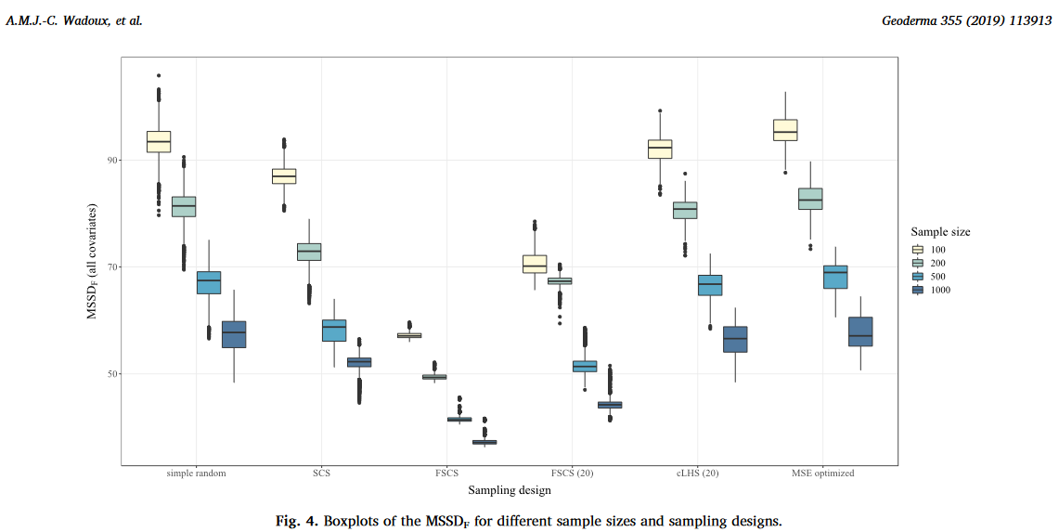
Mean Squared Shortest Standardized Distance

Slide 31
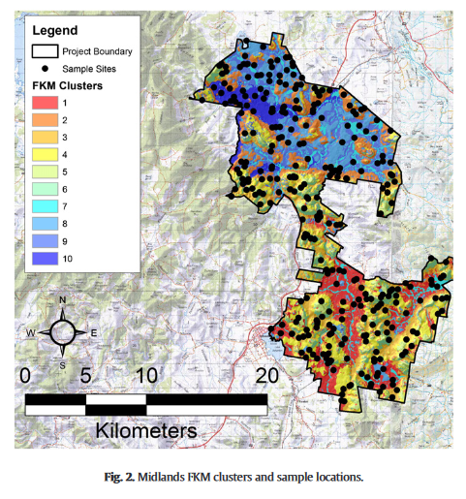
Example from Kidd et al. (2015)
Kidd et al. (2015)

Slide 32
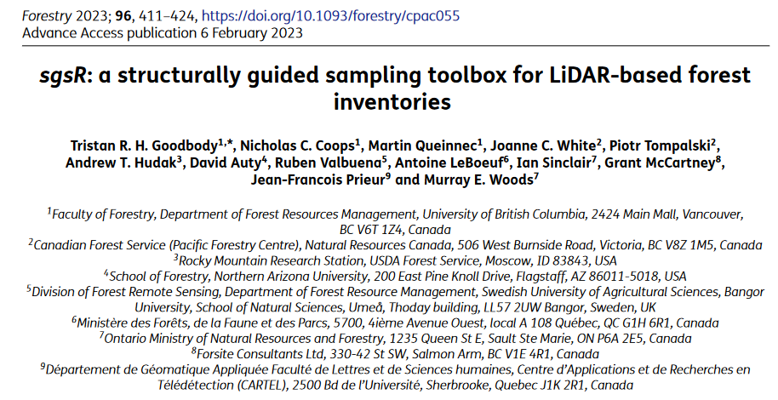
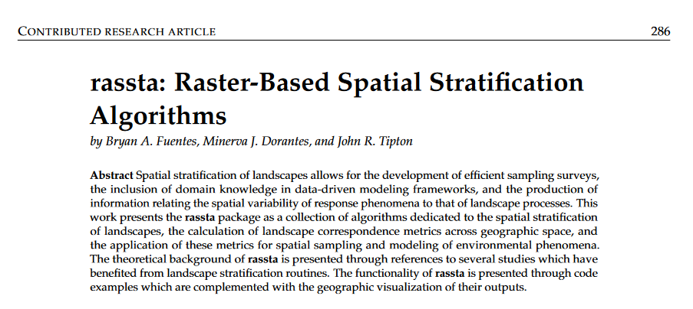
R packages for CSCS

Slide 33
Post-stratified Estimation of Accuracy
If the inclusion probabilities of the sample don’t match the population, their estimates will be biased.
Disproportional samples per strata (i.e. bias) can be good to increase the precision of estimates for small/important classes.
If our samples is disproportionate, we need to correct for it in our estimates by weighting them.

Slide 34
Example of weighting
Component/Class A
90 %
Samples = c(2.1, 0.8, 1.1, 0.3, 1.4, 0.9, 0.9, 0.6, 1.3, 1.5)
Mean = 1.1
Population
Mean = 1.5
Sample
Weighted Mean = 1.4
Unweighted Mean = 2.8
Component/Class B
10 %
Samples = c(5.1, 3.4, 4.5, 4, 3.9, 5.5, 4.7, 5.5, 4.2, 4.1)
Mean = 4.5

Slide 35
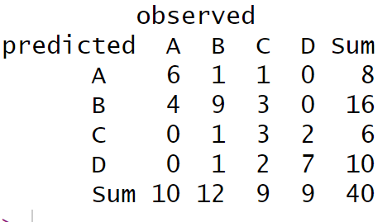
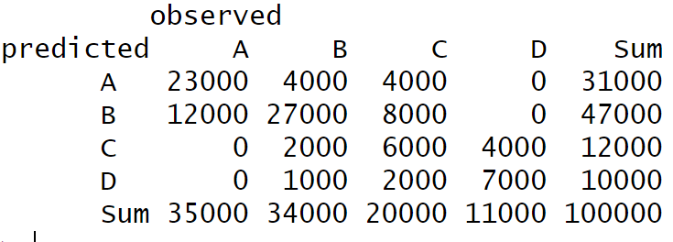
Example of Weighted Confusion Matrix
Unweighted
Weighted

Slide 36
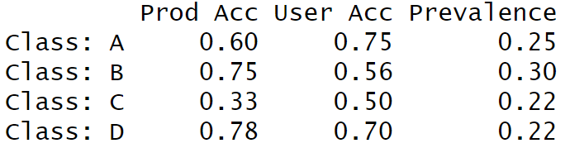
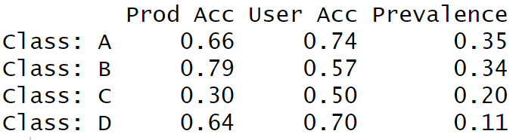
Example of Weighted Class-wise Accuracy
Unweighted
Weighted

Slide 37
References
Brus DJ. 2022. Spatial Sampling with R [Internet]. 1st ed. Boca Raton: Chapman and Hall/CRC. https://doi.org/10.1201/9781003258940
Fuentes BA, Dorantes MJ, Tipton JR. 2022. rassta: Raster-Based Spatial Stratification Algorithms. The R Journal. 14(2):288–309. https://doi.org/10.32614/RJ-2022-036
Goodbody TRH, Coops NC, Queinnec M, White JC, Tompalski P, Hudak AT, Auty D, Valbuena R, LeBoeuf A, Sinclair I, et al. 2023. sgsR: a structurally guided sampling toolbox for LiDAR-based forest inventories.Fassnacht F, editor. Forestry. 96(4):411–424. https://doi.org/10.1093/forestry/cpac055
Kidd D, Malone B, McBratney A, Minasny B, Webb M. 2015. Operational sampling challenges to digital soil mapping in Tasmania, Australia. Geoderma Regional. 4:1–10. https://doi.org/10.1016/j.geodrs.2014.11.002
Ma T, Brus DJ, Zhu A-X, Zhang L, Scholten T. 2020. Comparison of conditioned Latin hypercube and feature space coverage sampling for predicting soil classes using simulation from soil maps. Geoderma [Internet]. 370:114366. https://doi.org/10.1016/j.geoderma.2020.114366
Pflugmacher D. mapac: R package for estimating map accuracy. GitLab. https://scm.cms.hu-berlin.de/pflugmad/mapac
Stehman SV. 2014. Estimating area and map accuracy for stratified random sampling when the strata are different from the map classes. International Journal of Remote Sensing. 35(13):4923–4939. https://doi.org/10.1080/01431161.2014.930207
Wadoux AMJ-C, Brus DJ, Heuvelink GBM. 2019. Sampling design optimization for soil mapping with random forest. Geoderma. 355:113913–113913. https://doi.org/10.1016/J.GEODERMA.2019.113913

